Slide 1

WELCOME

Slide 2
The Anglo-French Conflict-Carnatic Wars
Introduction
Europeans came for Trade.
Deteriorating condition prevailed in TN
British, French interfered into the affairs of local rulers and TN.
Pondicherry-HQ of French-political affairs of Nawab of Arcot unnecessarily
St.George fort-British HQ-Marathas affairs
They wanted to establish their political and economic domination in TN
So French and British became enemies and waged many wars.
They are called Carnatic Wars.
It lasted for 20 years

Slide 3
1 Carnatic War (1746-48)
Causes
  Anglo and French commercial and colonial. rivalaries in India and Europe.
  Austrian War of Succession was broken out b/w Austria and Prussia in 1740.
  England supported Austria
  Hence Prussia sought the support of French
  It echoed in Indian colonies.
  DUPLEX ------French Governor of Pondicherry made to prevent war in India but it ended in failure………..

Slide 4
Events
In 1741-British navy under Barnett captured a few French ships without prior intimation.
He decided to capture Madras also
Shocked Duplex asked help to La-Bourdonnais, the Governor of Mauritius
La sent an army to help Duplex
It stormed madras in 1746.
Afraid commander left Madras in the hands of French.
Nicolas, a Governor of Madras unconditionally surrendered before the French.
La concluded a peace treaty with the British and demanded a ransom of Rs.40000 to French to release Madras.
But Duplex refused to this peace treaty.

Slide 5
Duplex besieged Madras after La departured and captured many British.
They were taken to Pondicherry as prisoners.
But soon political situation changed in favour of British
Anwarudin, the nawab of Carnatic ordered French to release Madras.
French refused
AN sent an army of 10000 under Mafuzkhan
But Duplex managed them with 1000 soldiers in Adyar
because they are untrained and indisciplined.
So French looted the madras city from day and night, from top to bottom

Slide 6
Aggressive Duplex tried to capture St.David fort at Cuddalour.
In this time, an army under Reer Admiral Boscowen, the British General attacked Pondicherry in 1748.
So Duplex came back for Pondicherry and defended Pondicherry.
The Austrian war came to end in Europe in 1748.
Result
Aix-la-Chapelle was signed
Madras was restored to the British, Louisburg (North America) to the French
French consolidated their position in TN
Europeans made alliance with native rulers for consolidation their position

Slide 7
Result
The Treaty of Pondicherry-1755
Mohammad Ali became the Nawab of Carnatic.
British and French agreed not to interfere into the internal affairs of the Native Rulers, gave back to conquered places, agreed to leave their earlier places.
helped the British to be more stronger

Slide 8
III rd Carnatic War-1756-1763
causes
1.Seven Years war broke out b/w English and French-continued in India also
2. Their peace treaty was short lived.
Notes:
Introduction

Slide 9
Events
Count-de-Lally-Governor General of French-India.
He Captured St.David Fort, turned his attention towards Madras.
To strengthen his army-he recalled the french General from Hydrabad (Nizam-Salabat Jung bro of N.J)
This blunder helped the Nizam to cross over to British
He offered the Northern Circar to the British
Notes:
Introduction

Slide 10

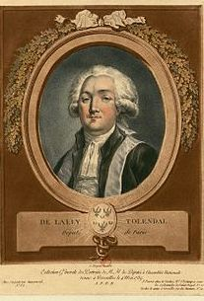
Count-de-Lally

Slide 11
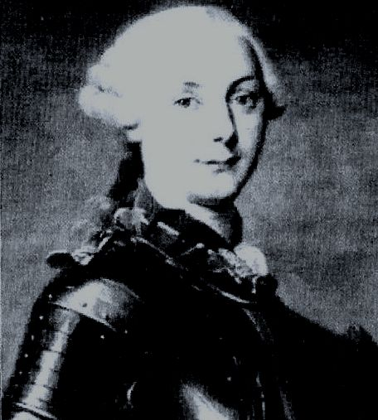
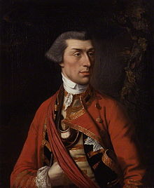
Bussy Sir Eyre Coote

Slide 12
Count-de-Lally was defeated (becos of distrust and jealousy among generals) by capturing Madras in the war of Wandewash in 1760 b/w Sir Eyre Coote and Bussy
It sealed the fate of French.
Bussy was imprisoned in 1760.
British captured Karikal, Mahe and Gingi.
Lally surrendered before the British in 1761.

Slide 13
Results
1.Seven Years war ended with the treaty of Paris in1763
2. French settlements were restored
3. Count was recalled
4. The French lost their power and prestige in India
Notes:
Introduction

Slide 14
Causes for the failure of French,
English-success
1.FEIC was a Govt owned, it neglected and not supported by the Govt.
but BEIC was a private one, had a sound financial position, supported by the Govt and Monarch.
2. French concentrated on territorial gains but British on trade
3. British Navy was more superior than the French navy.
Notes:
Introduction

Slide 15
British settlements in Bombay, Calcutta and Madras were better trade centres as well as military & commercial centres than the French centres of Mahe, Pondicherry and Chandranagore.
B commanders and Generals were well experienced and clever. Robert Clive and Eyre Coote were having perfect understanding. But French generals looked at one another with jealousy and distrust.

Slide 16

THANK YOU

